Slide 1
DEEP RESIDUAL LEARNING FOR IMAGE RECOGNITION
Graduate Group 13
Nihitha Reddy Seelam
Paavana Raghunandan Vallabhaneni
Sajith Muralidhar

Slide 2
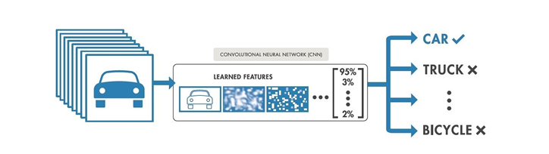
Introduction of CNN (Convolutional Neural Network)
CNN algorithm learns to identify complex patterns in images and videos through a process of feature extraction, dimensionality reduction, and classification/regression.
Integrates low/mid/high-level features and classifiers in an end-to-end multilayer fashion
Deeper features achieve better representation of data.

Slide 3
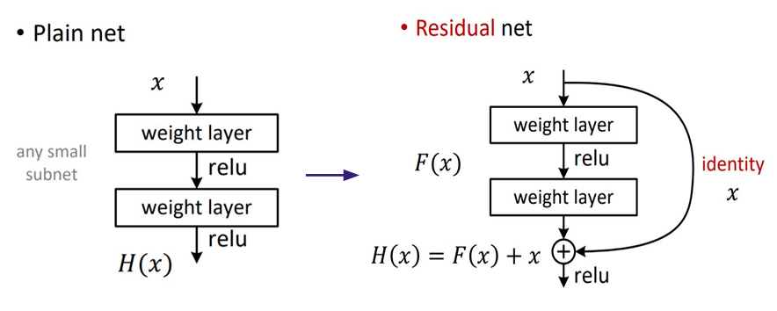
Introduction to Deep Residual Network
A sort of specialized neural network called a deep residual network (deep ResNet) aids in handling more complex deep neural networks.
Utilizing residual blocks, which rely on residual mapping to maintain inputs, the deep residual network addresses some of these issues. Engineers can test deeper networks that provide unique training difficulties by applying deep residual learning frameworks.

Slide 4
Datasets
We will use CIFAR-10 and CIFAR-100 datasets
Key Feature of CIFAR-10: Consists of 60,000 32x32 size images. Mostly used in CNN models.
Key Feature of CIFAR-100: Consists of 60,000 32x32 size images with 100 classes (20 super classes , each super class having 5 classes).
Dataset is referred from Kaggle.
CIFAR-10: https://s3.amazonaws.com/fast-ai-imageclas/cifar10.tgz
CIFAR-100: https://s3.amazonaws.com/fast-ai-imageclas/cifar100.tgz

Slide 5
Techniques
To proceed with our project, we plan on using these methods: -
Data Normalization: - Data Normalization is a pre-processing technique used to standardize data. Having different sources of data inside the same range. Not normalizing the data before training can cause problems in our project, making it drastically harder to train and decrease its learning speed.
Residual connections: - Adds the original input to the output feature by passing the input feature map through one or more convolutional layers. We will use Resnet9 architecture
Batch normalization: - Like data normalization except it normalizes the output of the previous layer.
We may use other methods or techniques but for now we are not sure on what we must use.

Slide 6
References
https://s3.amazonaws.com/fast-ai-imageclas/cifar10.tgz
https://s3.amazonaws.com/fast-ai-imageclas/cifar100.tgz
https://www.researchgate.net/publication/311609041_Deep_Residual_Learning_for_Image_Recognition

Slide 7
Thank you
Graduate Group 13

